Slide 1


Computer Applications to Behavioral Sciences
Lecture 7. List
何吉波，博士
清华大学用户体验学科负责人
优视眼动科技公司创始人
http://www.usee.tech

Slide 2
A List is a kind of Collection
A collection allows us to put many values in a single “variable”
A collection is nice because we can carry all many values around in one convenient package.
friends = [ 'Joseph', 'Glenn', 'Sally' ]
carryon = [ 'socks', 'shirt', 'perfume' ]

Slide 3
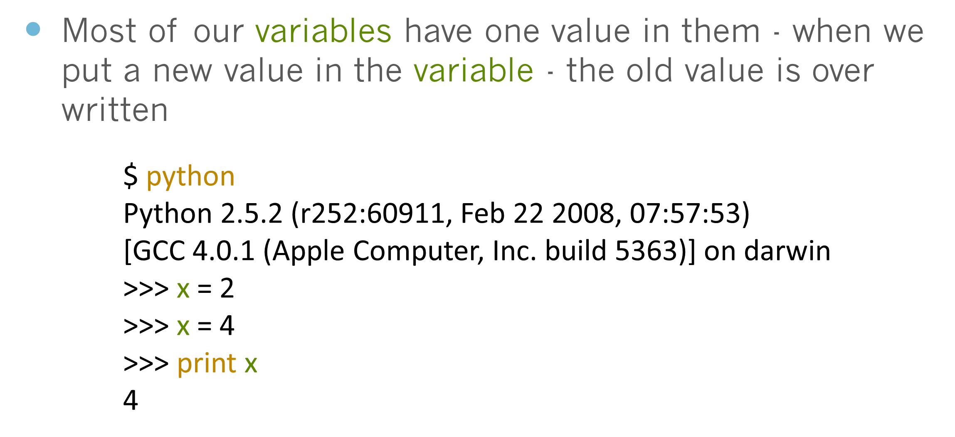
What is not a “Collection”

Slide 4
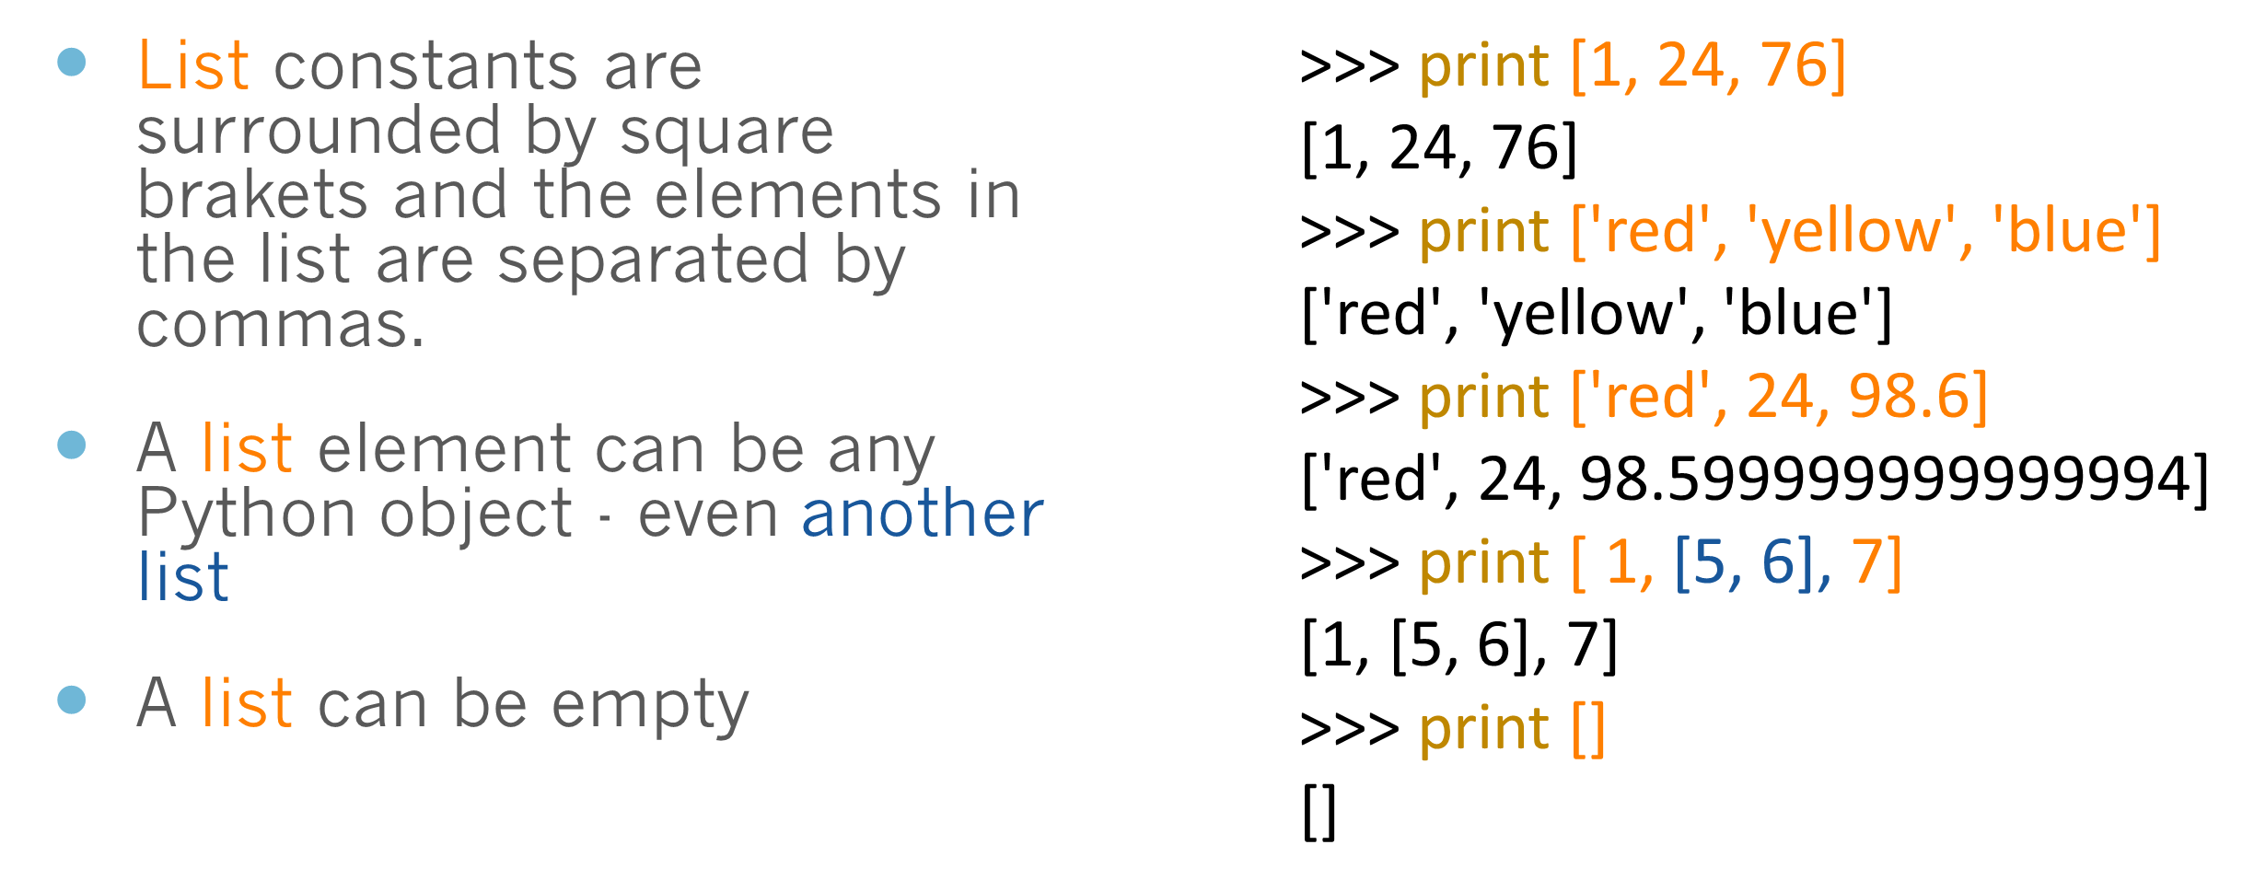
List Constants

Slide 5
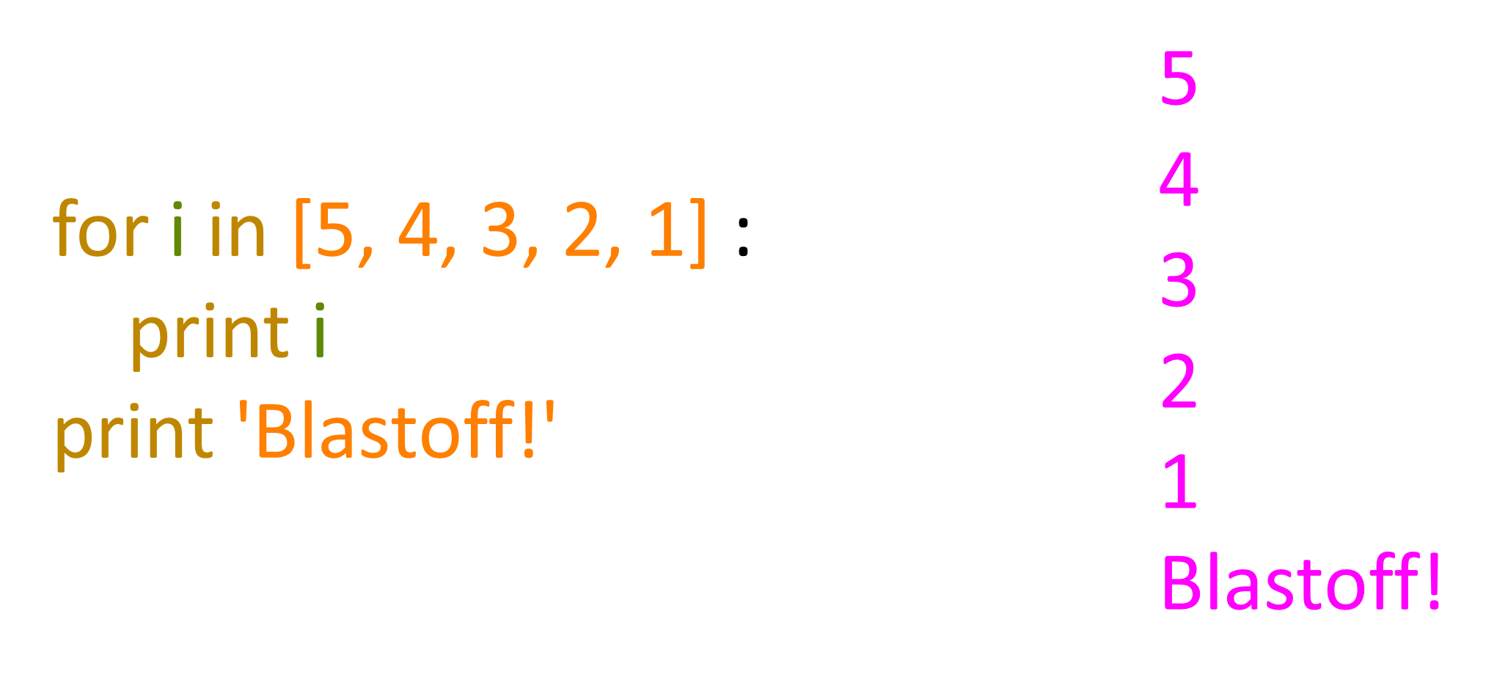
We already use lists!

Slide 6
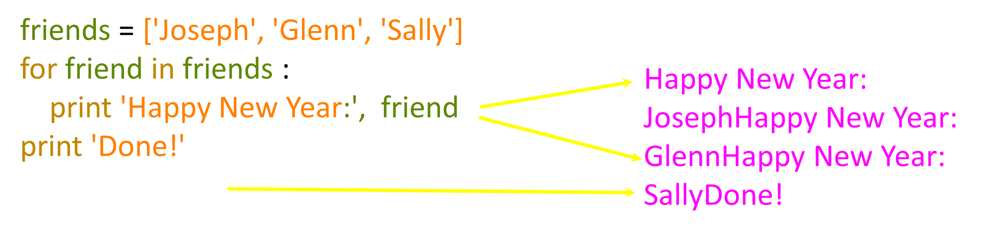
Lists and definite loops - best pals

Slide 7
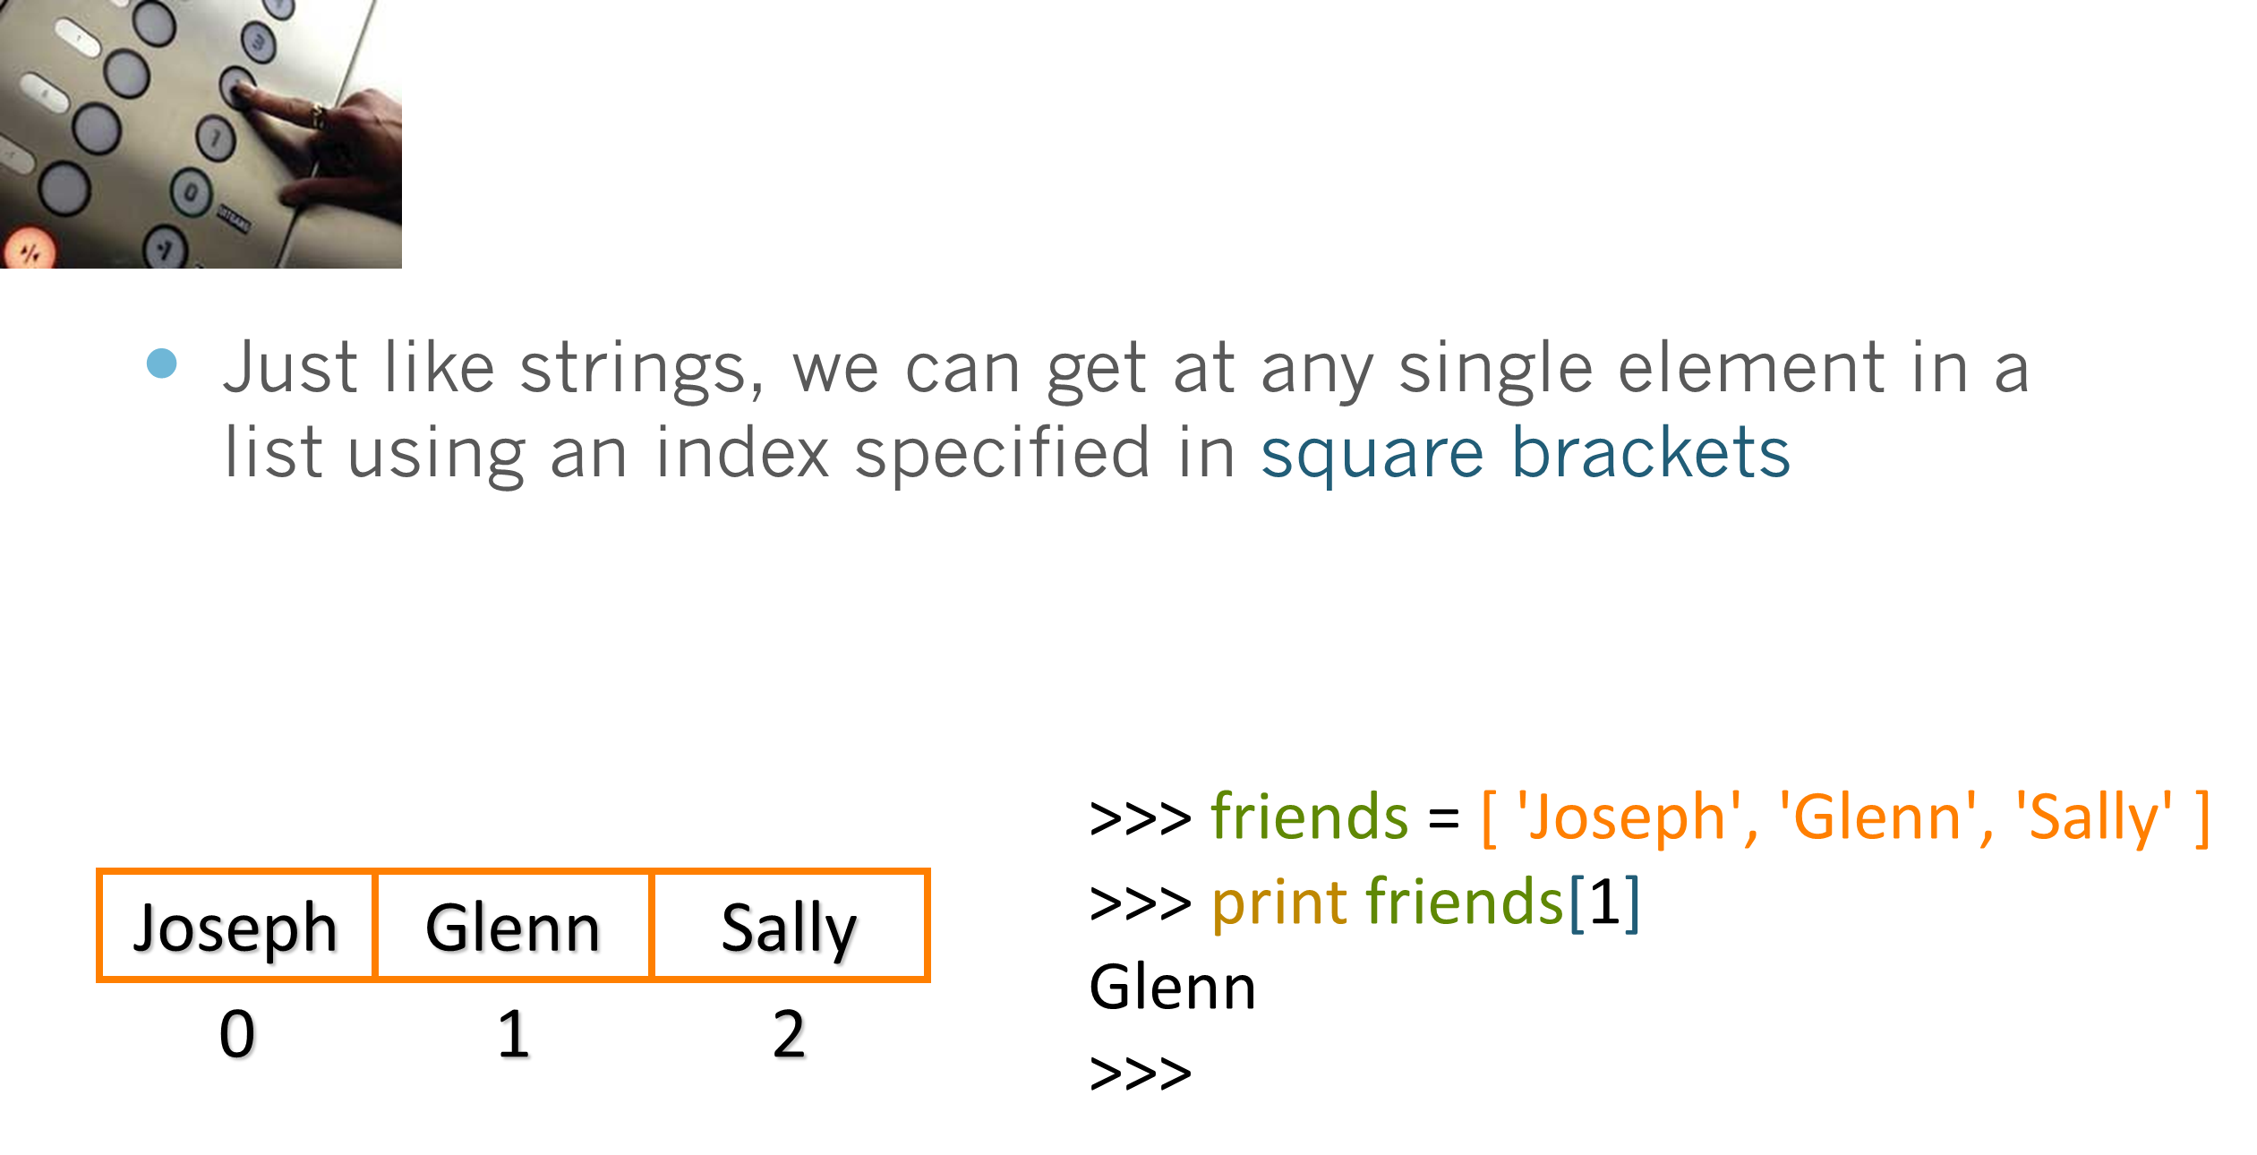
Looking Inside Lists

Slide 8
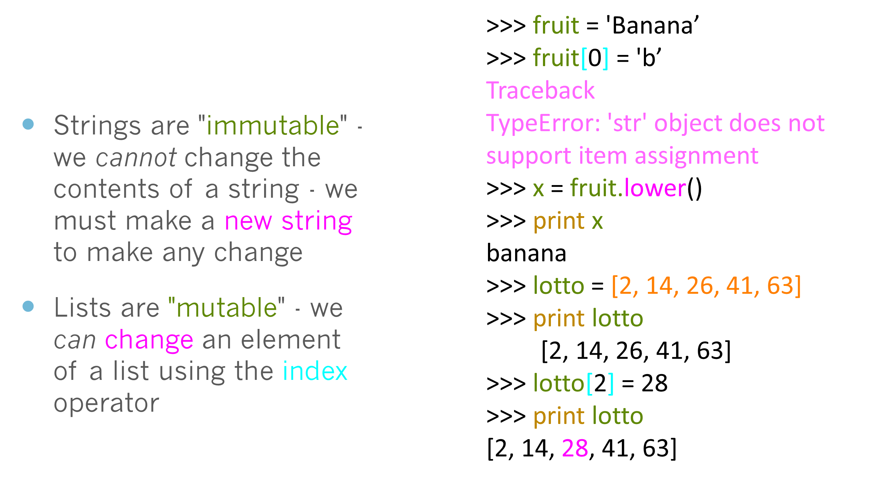
Lists are Mutable

Slide 9
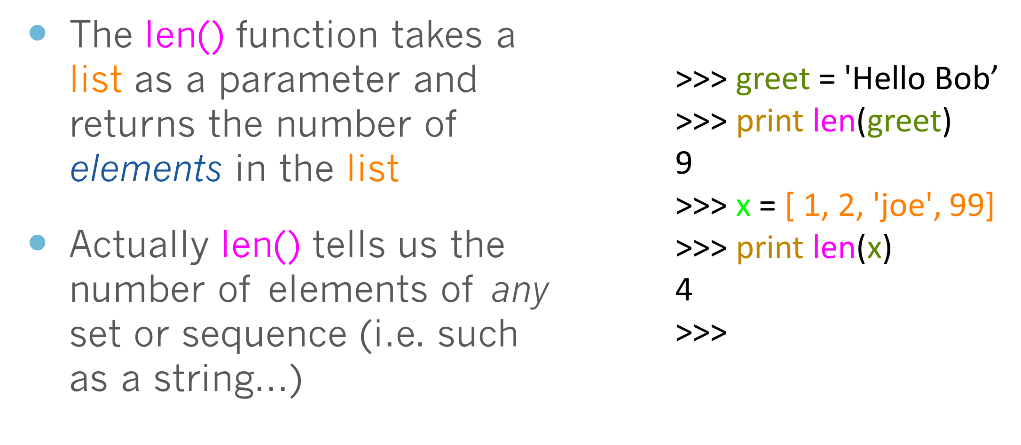
How Long is a List?

Slide 10
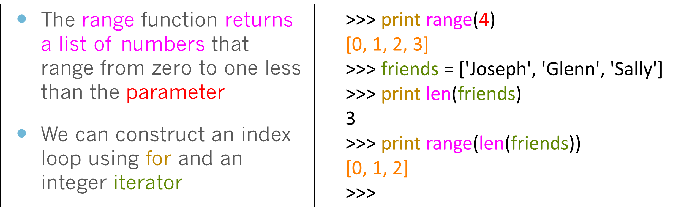
Using the range function

Slide 11
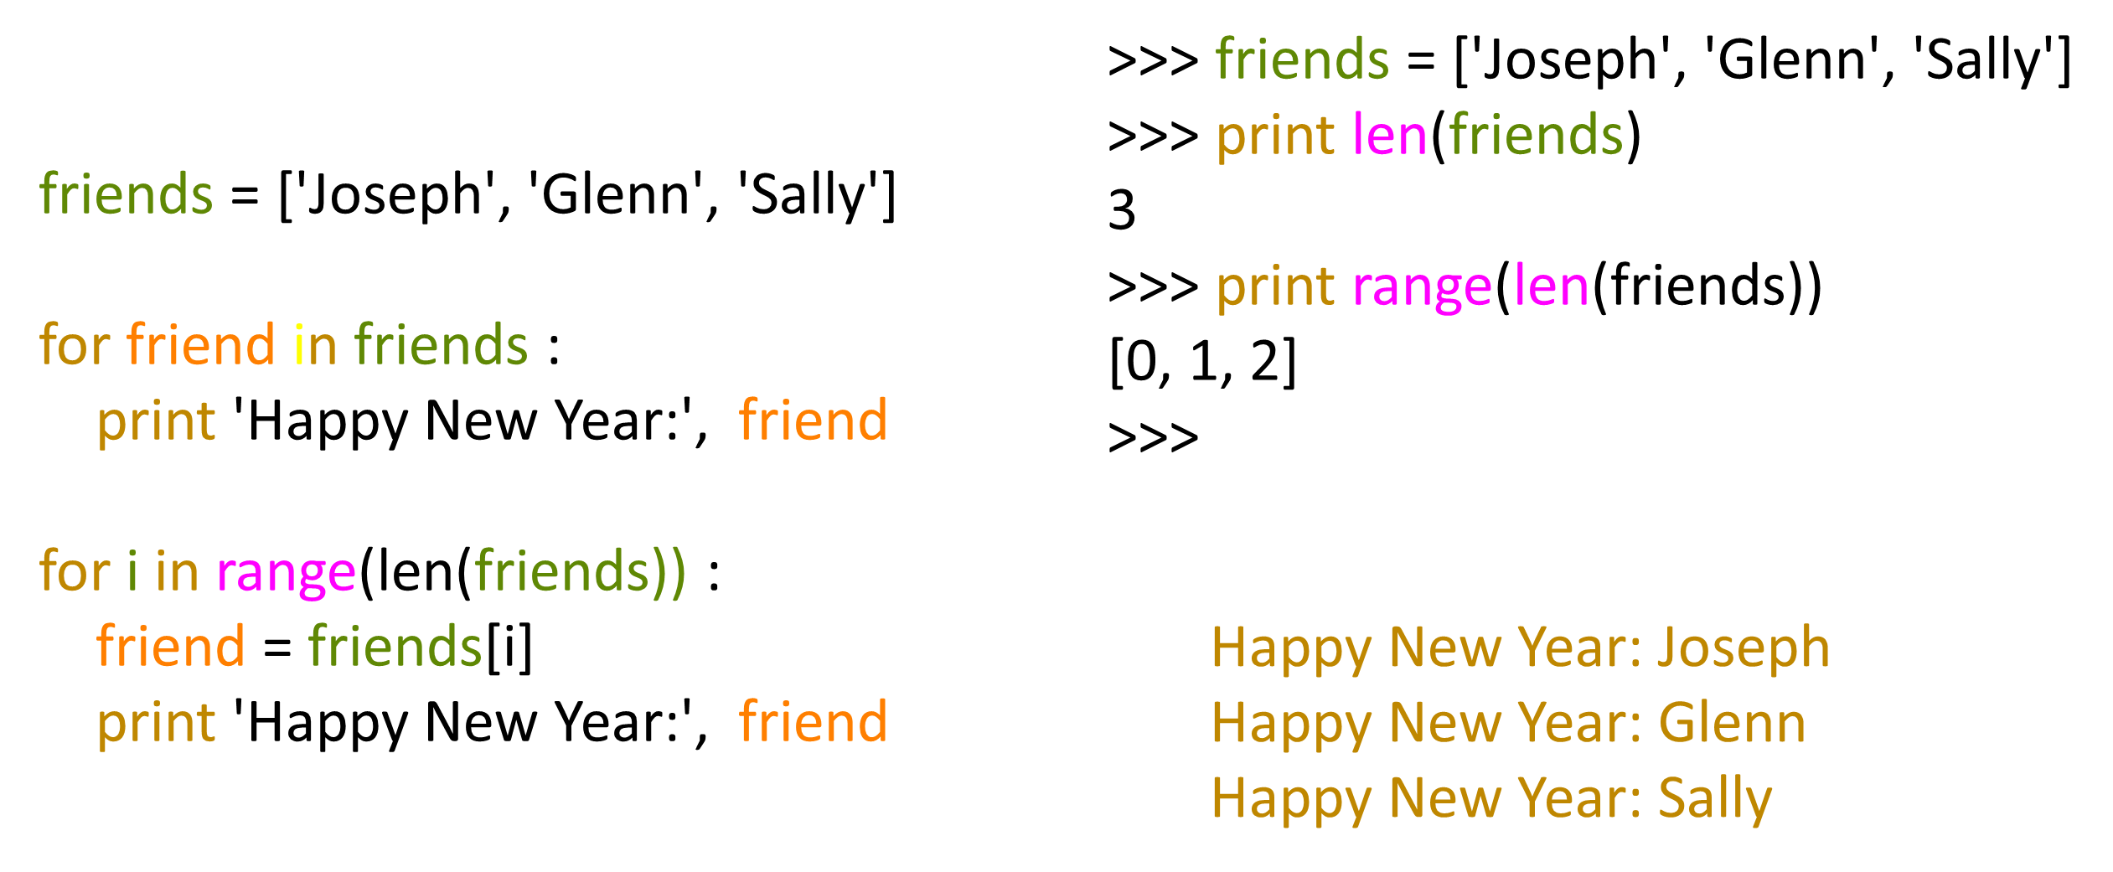
A tale of two loops...

Slide 12
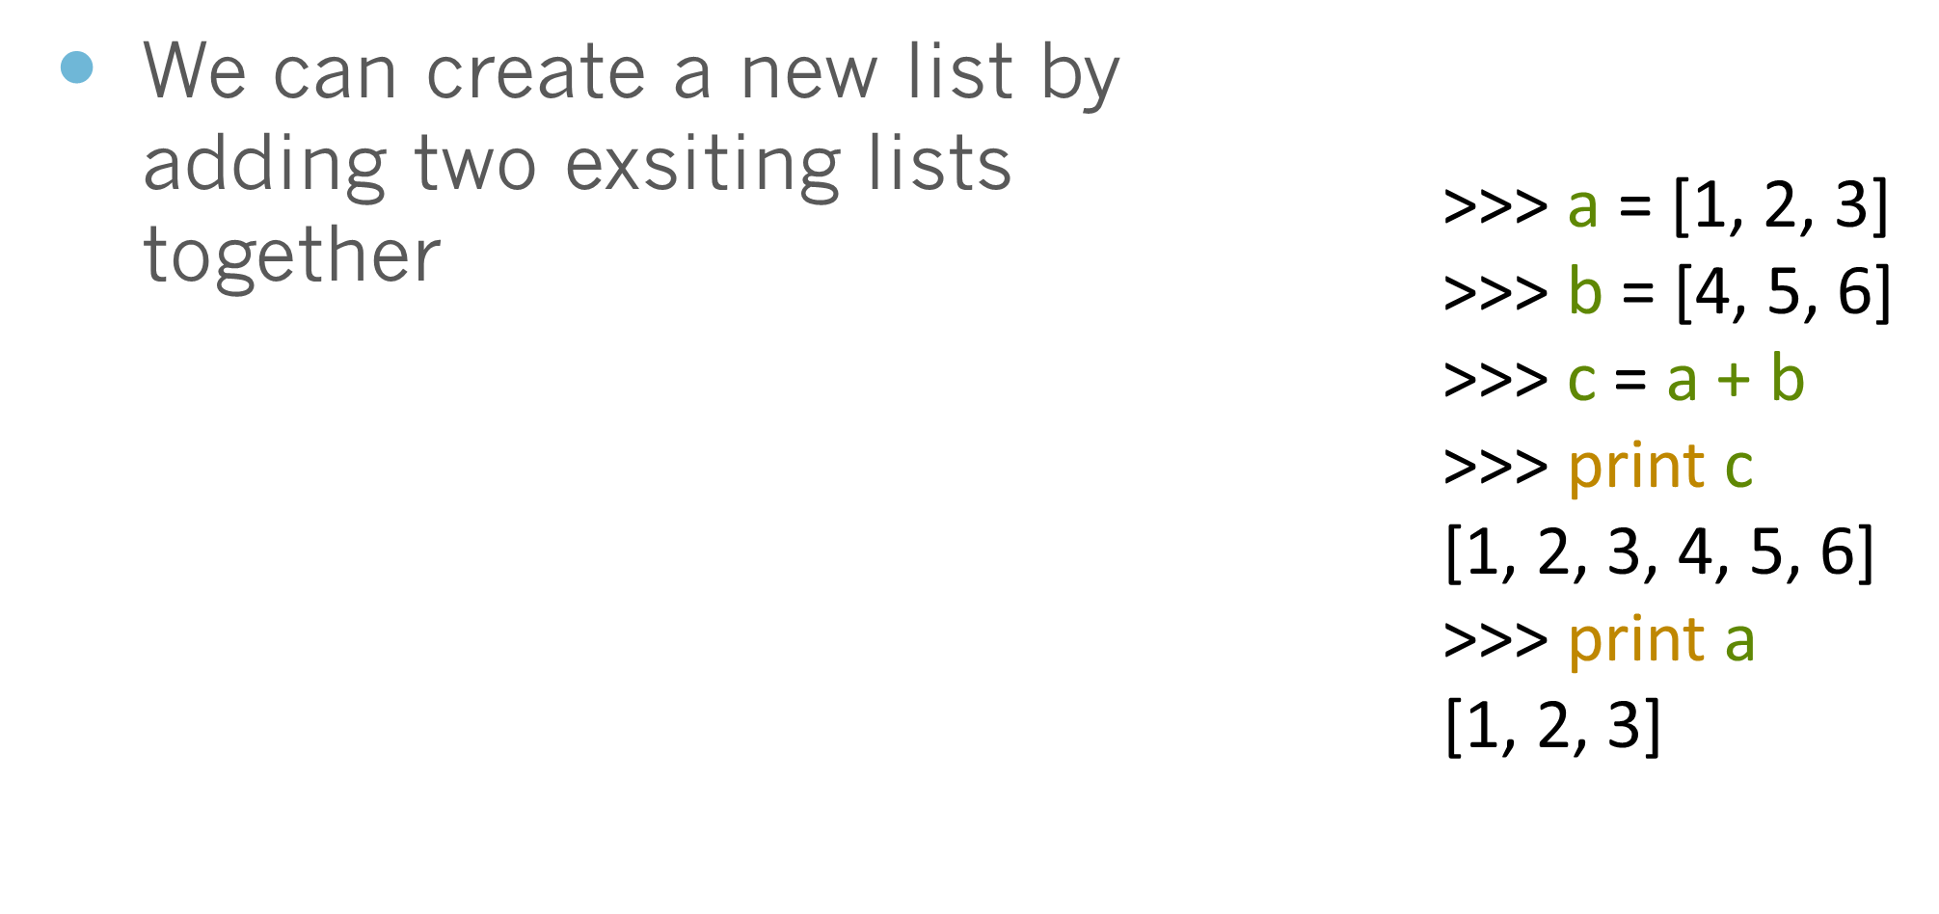
Concatenating lists using +

Slide 13
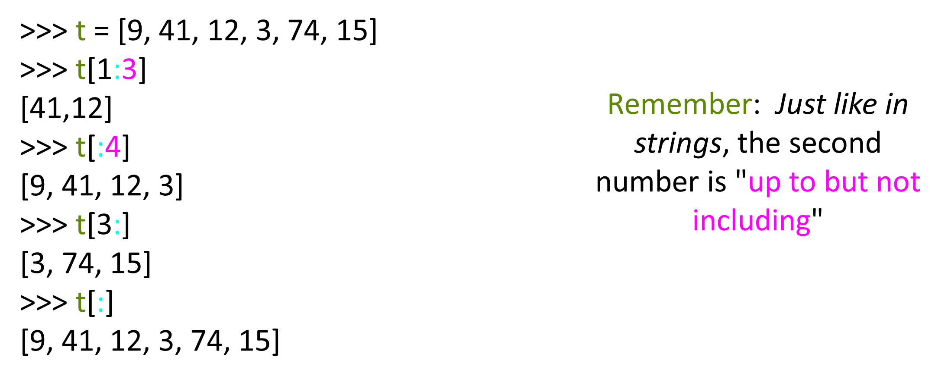
Lists can be sliced using :

Slide 14
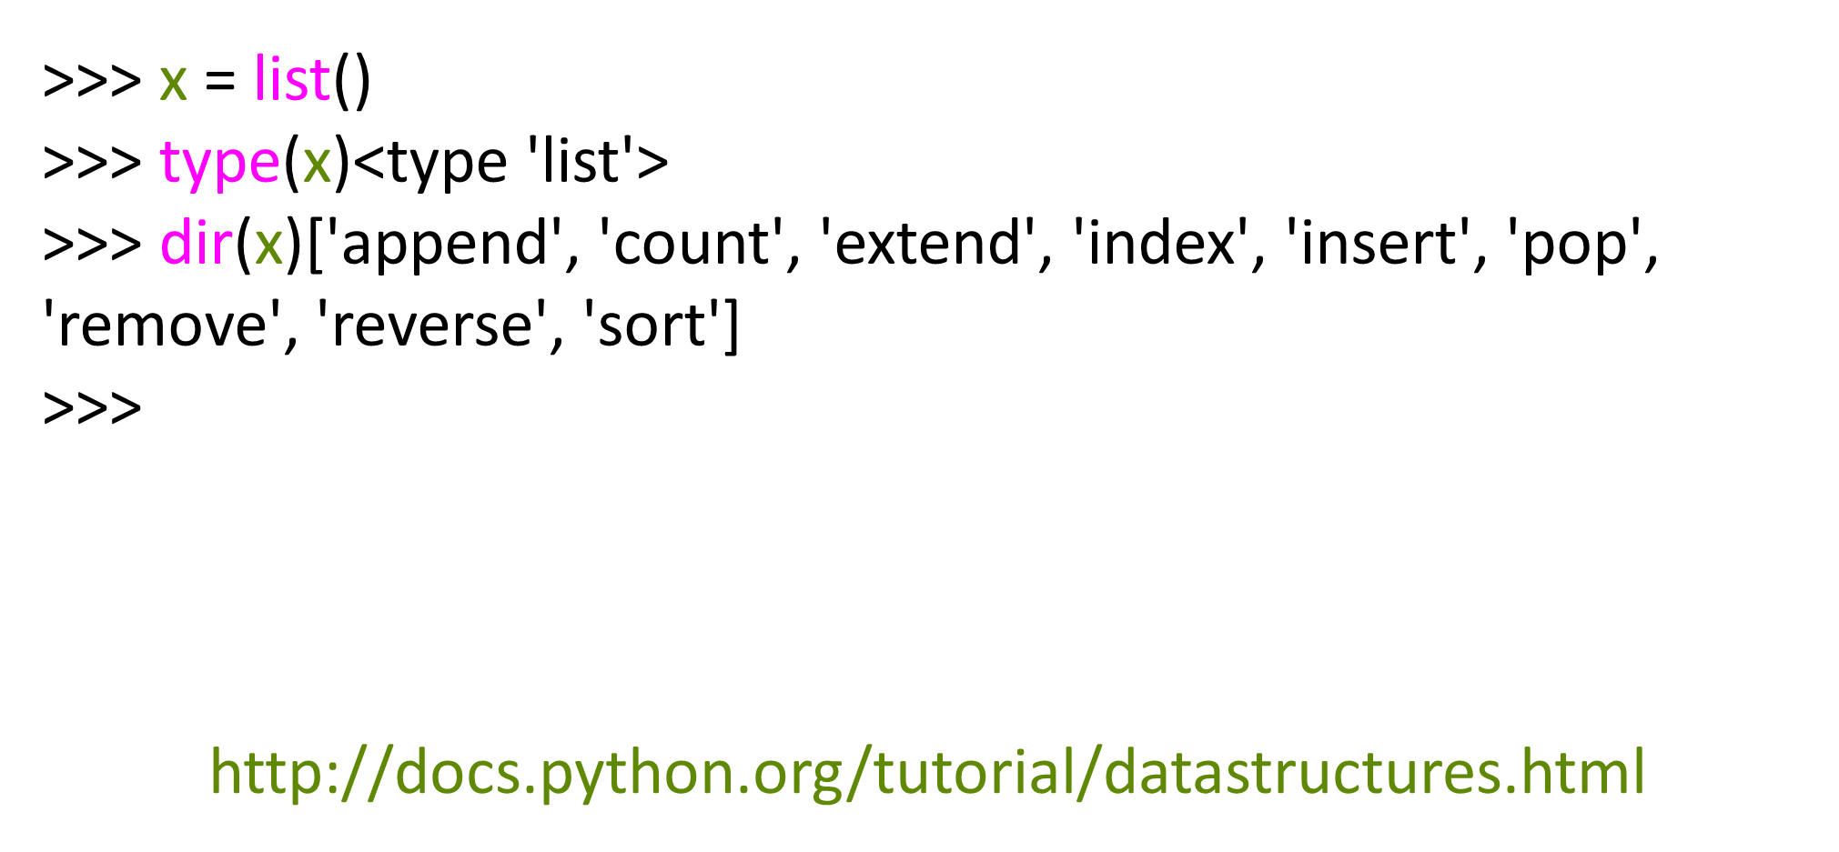
List Methods

Slide 15
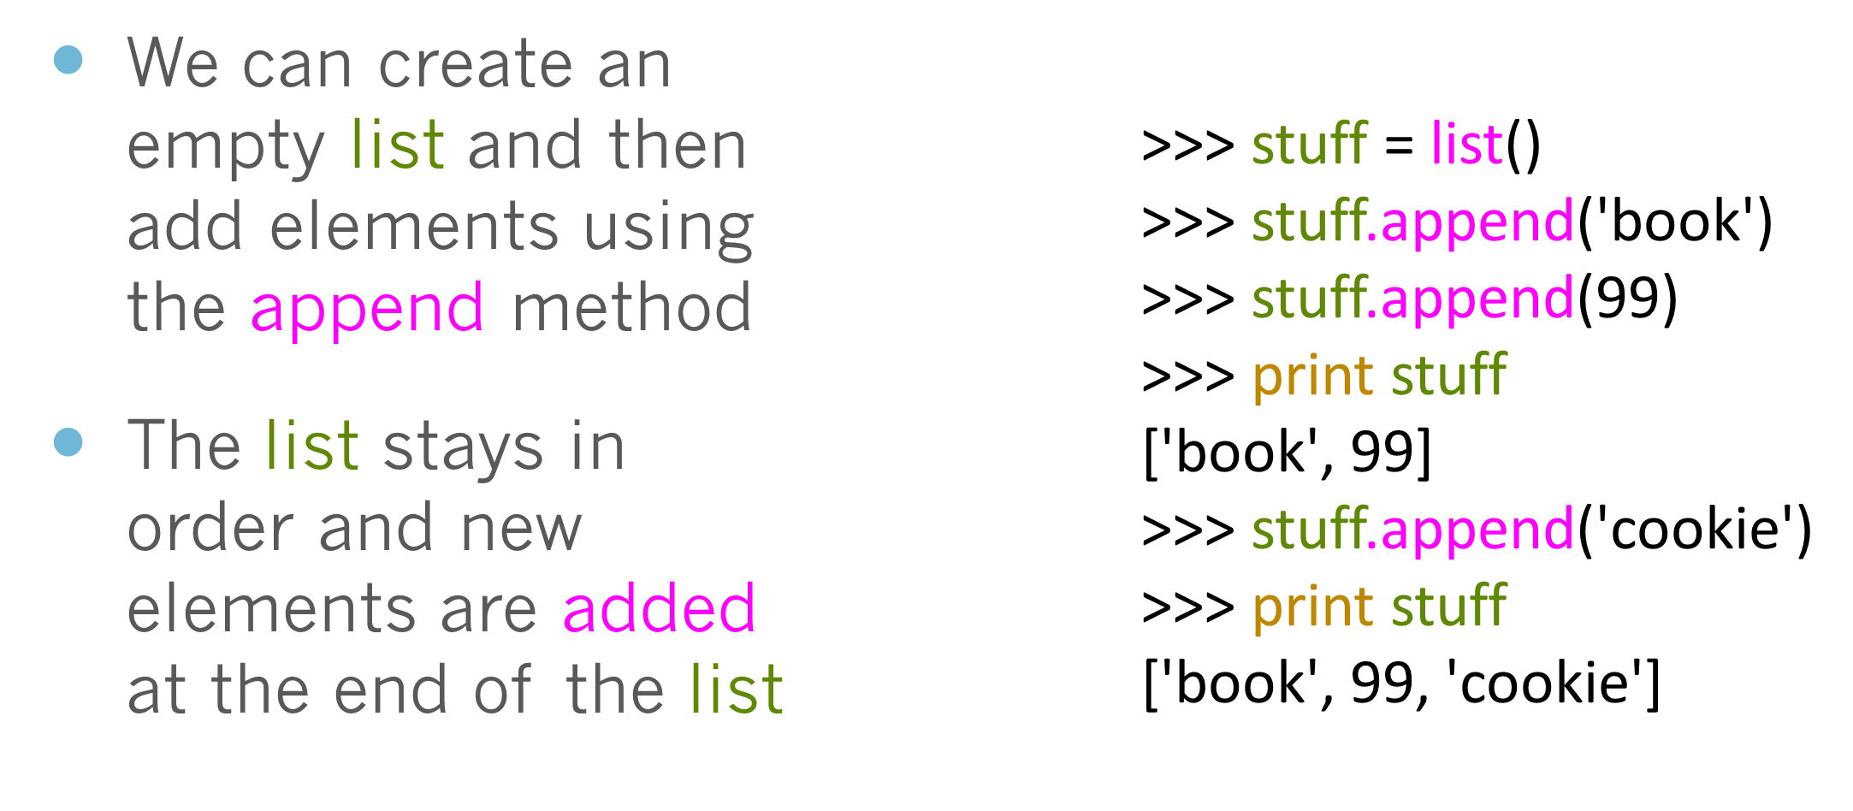
Building a list from scratch

Slide 16
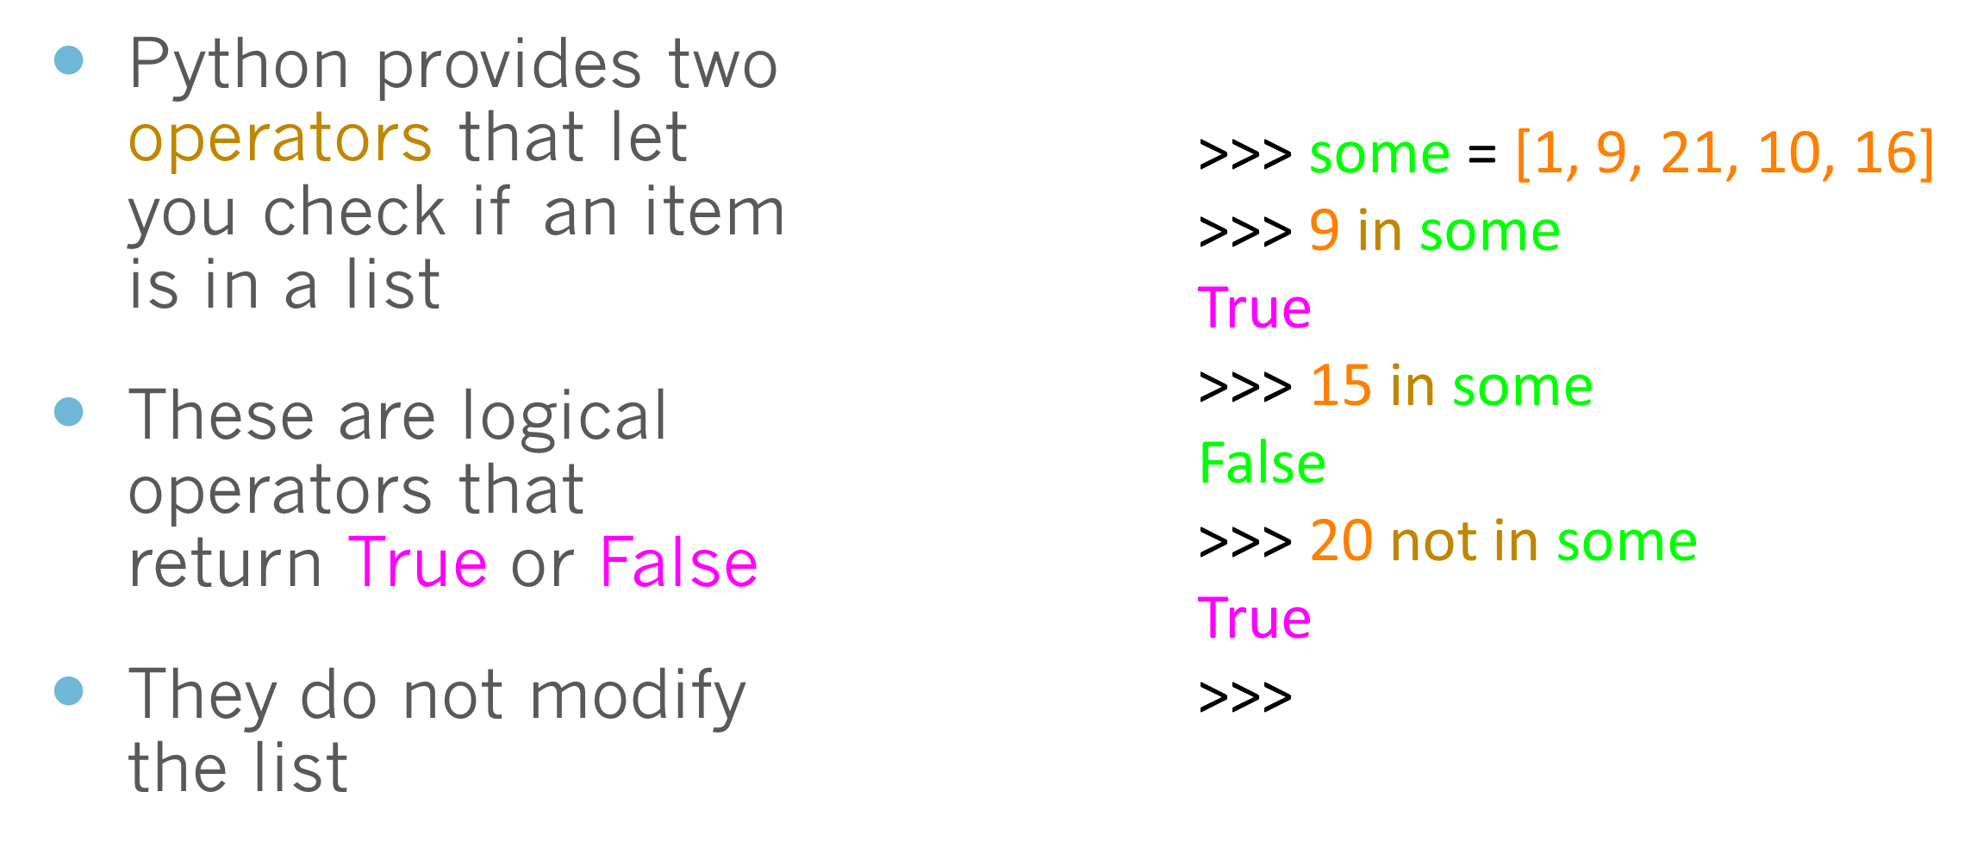
Is Something in a List?

Slide 17
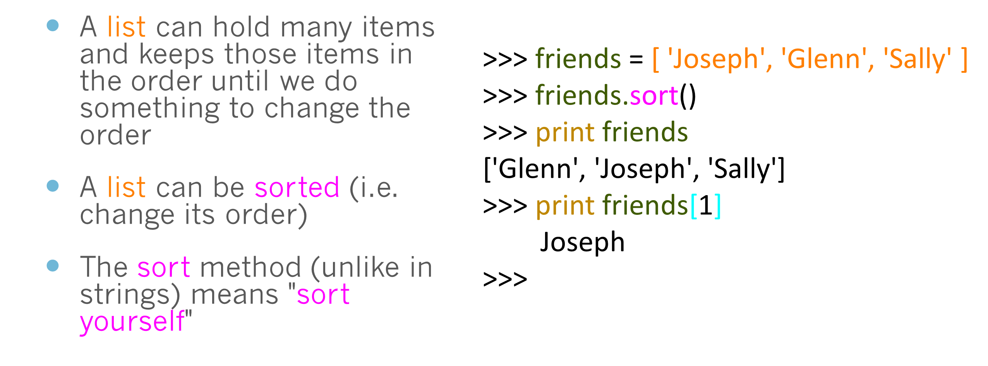
A List is an Ordered Sequence

Slide 18
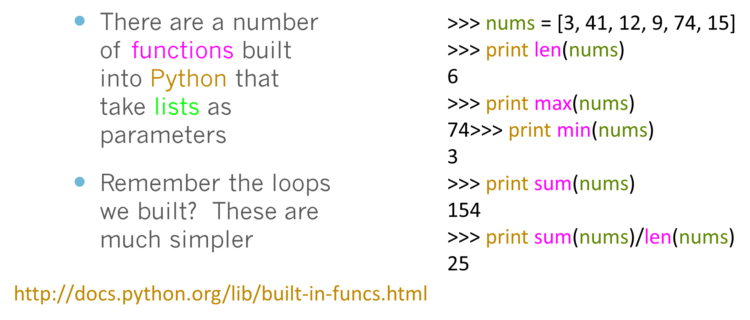
Built in Functions and Lists

Slide 19
total = 0
count = 0
while True :
inp = raw_input('Enter a number: ')
if inp == 'done' : break
value = float(inp)
total = total + value
count = count + 1
average = total / count
print 'Average:', average
numlist = list()
while True :
inp = raw_input('Enter a number: ')
if inp == 'done' : break
value = float(inp)
numlist.append(value)
average = sum(numlist) / len(numlist)
print 'Average:', average
Enter a number: 3
Enter a number: 9
Enter a number: 5
Enter a number: done
Average: 5.66666666667

Slide 20
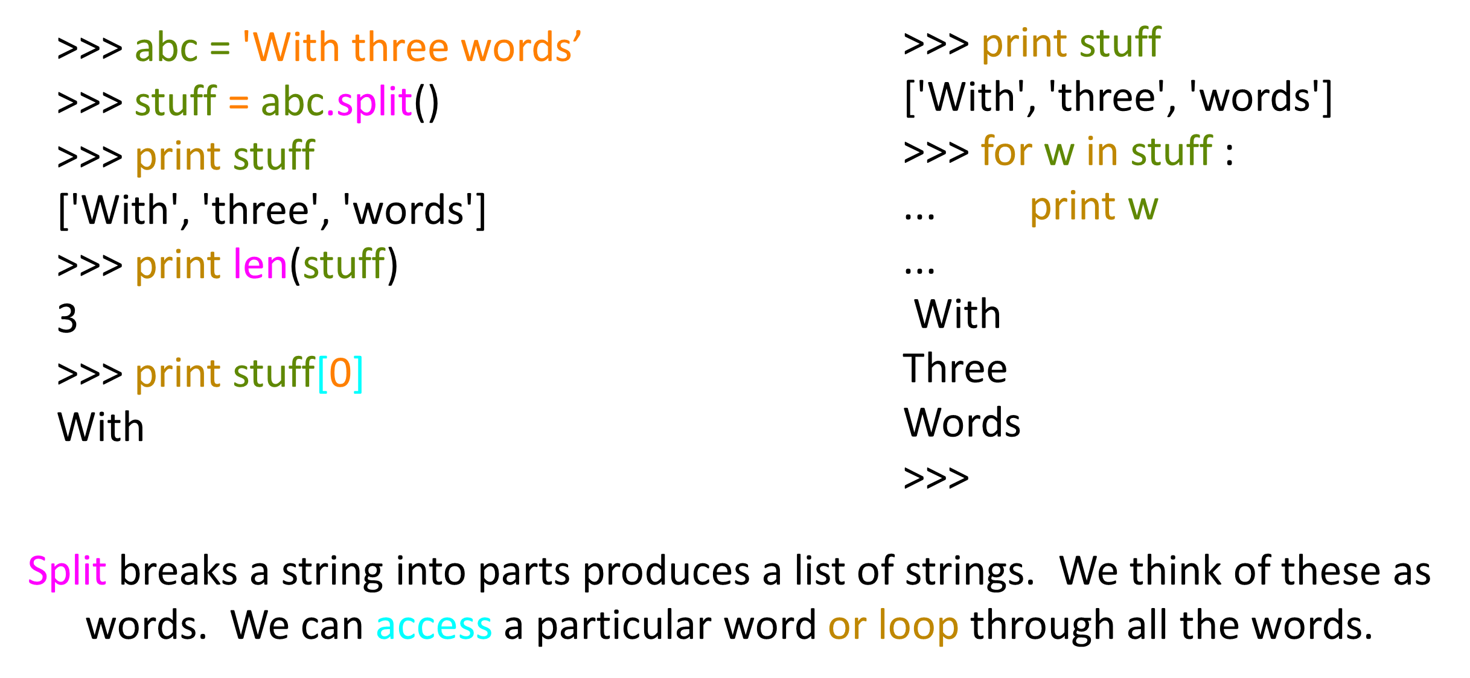
Best Friends: Strings and Lists

Slide 21
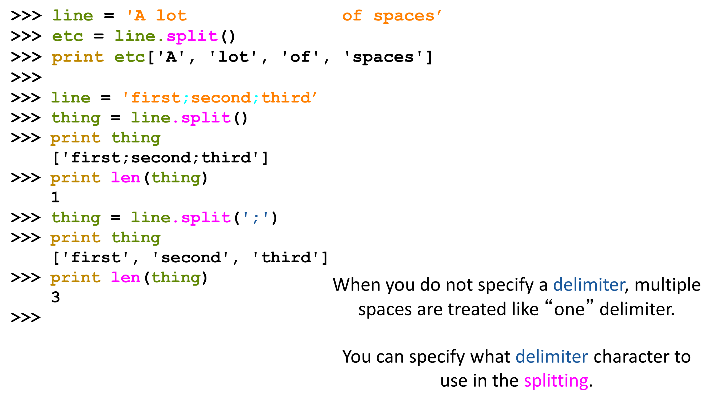
String Concatenation

Slide 22
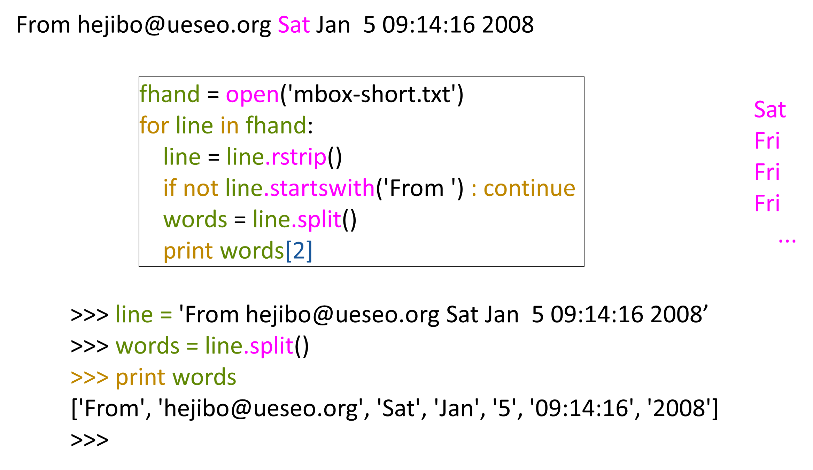
Using in as an Operator

Slide 23
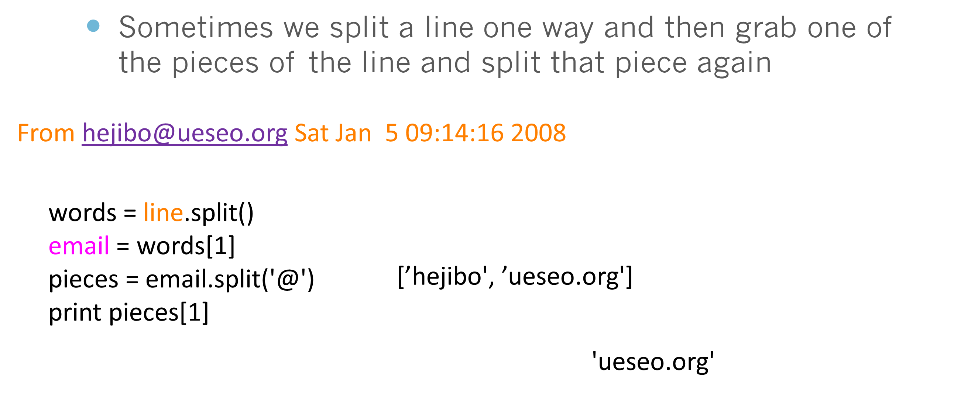
The Double Split Pattern

Slide 24
List Summary
Concept of a collection
Lists and definite loops
Indexing and lookup
List mutability
Functions: len, min, max, sum
Slicing lists
List methods: append, remove
Sorting lists
Splitting strings into lists of words
Using split to parse strings

Slide 25
Thank You

